Slide 1

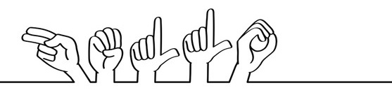


SignMeUp
H
E
L
L
O
21/09/2021
Machine Learning & Content Analytics

Slide 2



The Team
We tried to compose a diverse team in order to cover and communicate all the different angles of the problem:
For a holistic view of the project, all members were engaged in every step, in a waterfall manner.
However, each one had high responsibility in his part.
Maria Sergoulopoulou , B.Sc. Business Administration
Communicate any business-oriented challenges
Business Report and Final Presentation
Georgios Zygoukis , B.Sc. Mathematics
Model Composition
Optimization
Giannis Sakkis, B.Sc. Information Technology
IT-related optimization
Coding

Slide 3


The idea
Less than 1% of the Greek population has knowledge of Sign Language!
Deaf people are socially and professionally discriminated…
We envisioned an application which would allow deaf people communicate with everyone. Without any knowledge of Sign Language!
An application:
With huge Social Impact.
Groundbreaking for the Greek reality and market as there is not so much research and progress in this topic.

Slide 4





Dataset creation
We had to create a dataset completely… from scratch!
An automated Jupyter Notebook:
Uses the computer’s Camera.
Collects streams of 7 photos with the according labeling and storage.
Let time to prepare and change angles.
An Idea..?

Slide 5
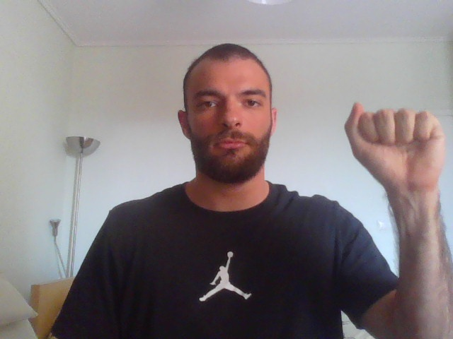
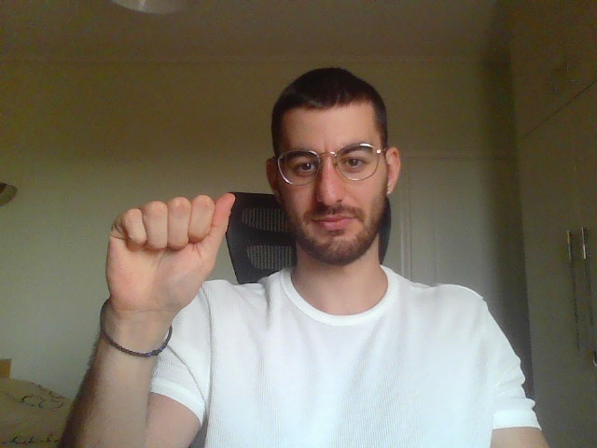
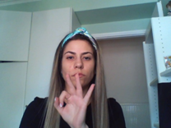
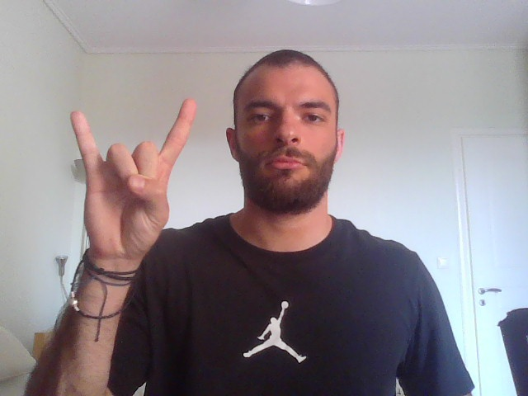
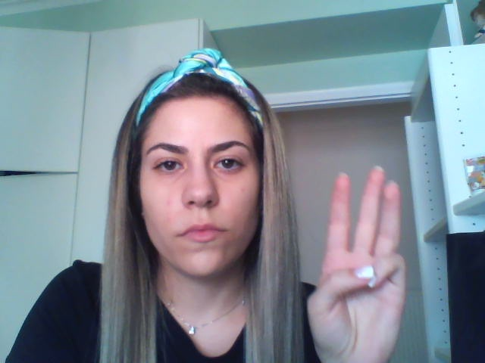
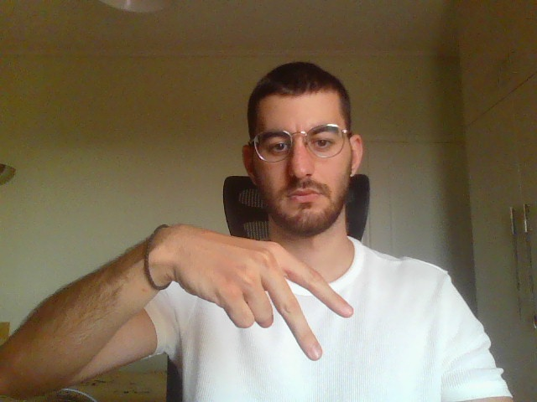
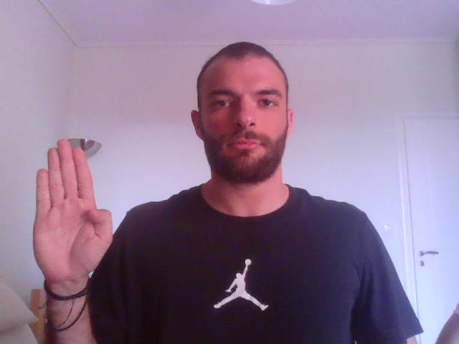
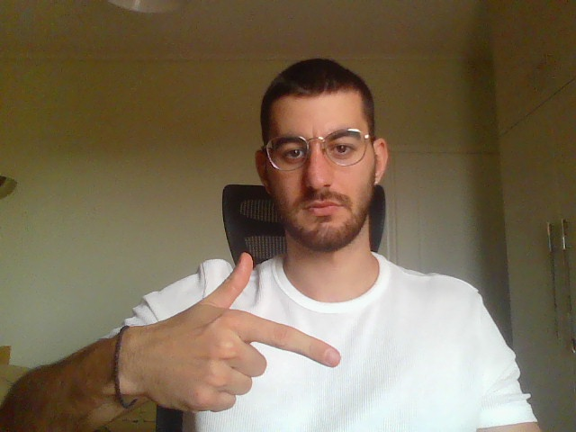
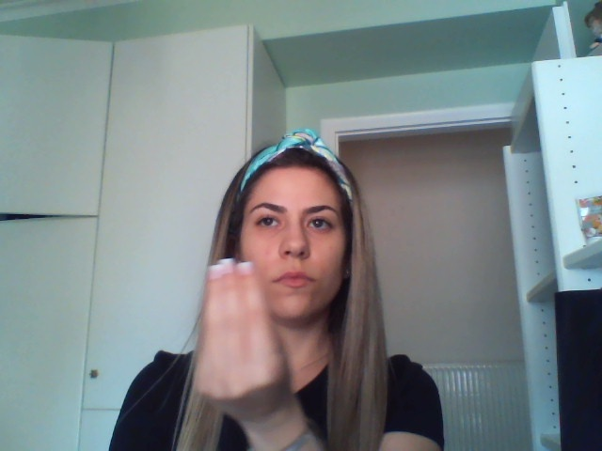

Dataset overview

Slide 6
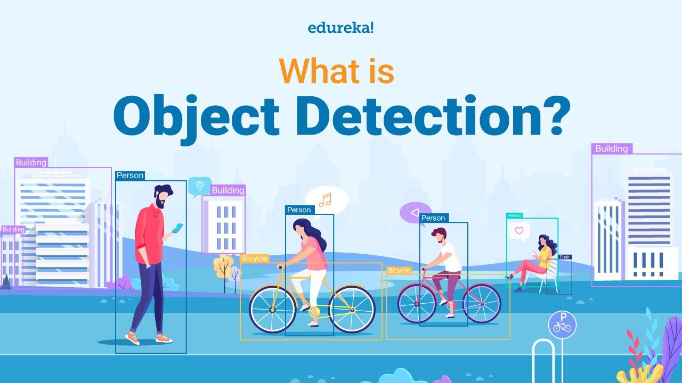

Object recognition
Identifying objects in digital photographs.
Object Detection combines:
Predicting the class of one object in an image.
Identifying the location of one or more objects in an image and drawing abounding box around their extent.

Slide 7
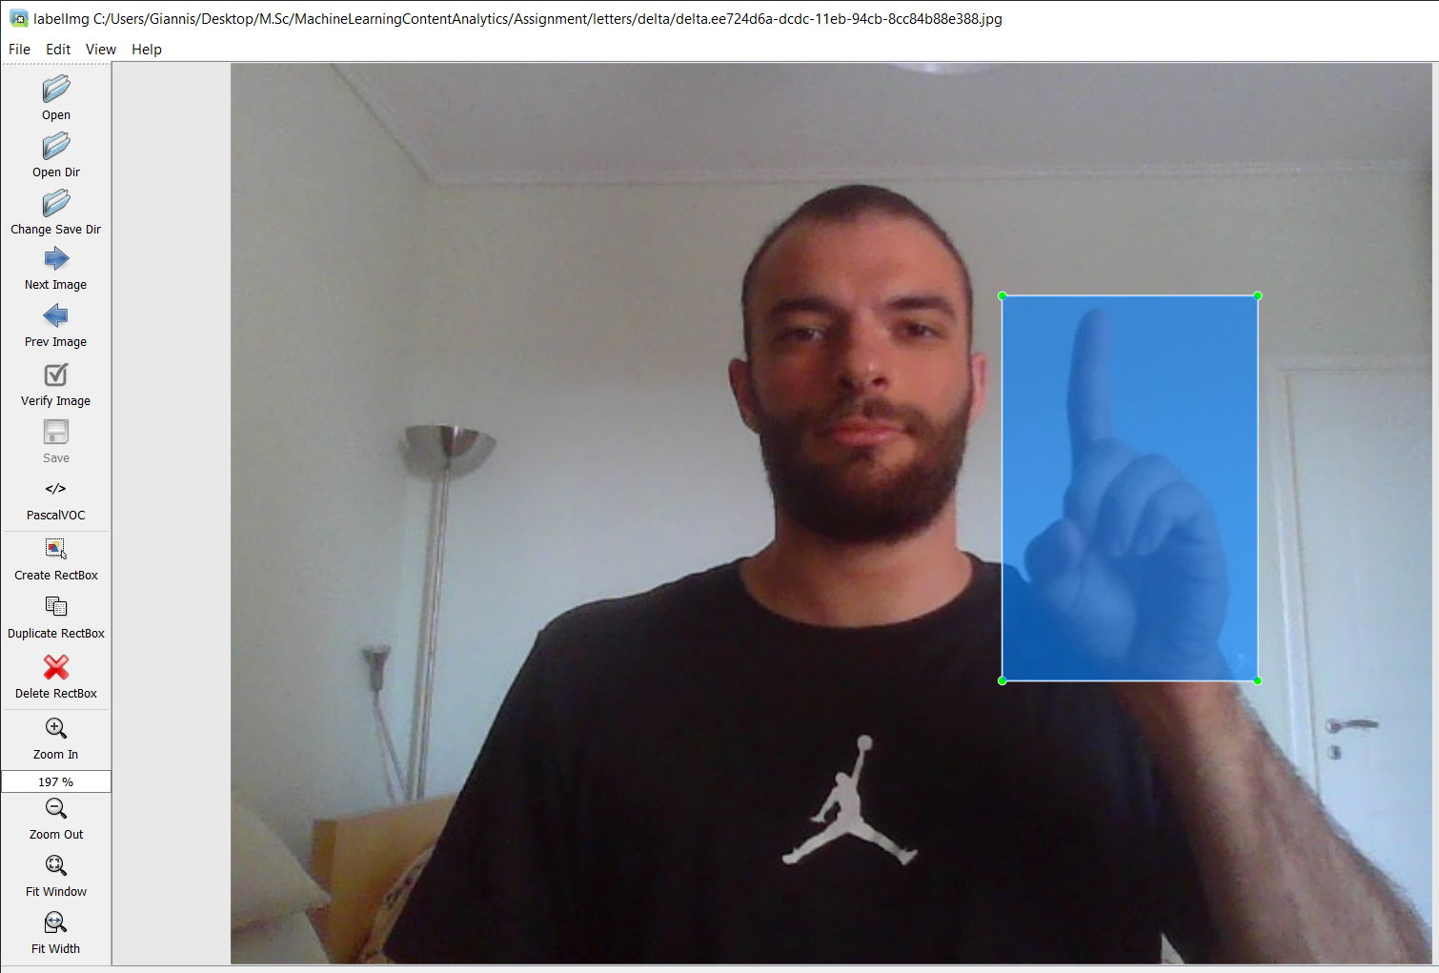
Annotation
In order to achieve Object Detection, we must train a model on an Annotated Dataset.
To do so:
We used Windows “LabelImg” application.
The output of the annotations was saved in the same folder where the according photo was stored respectively.

Slide 8
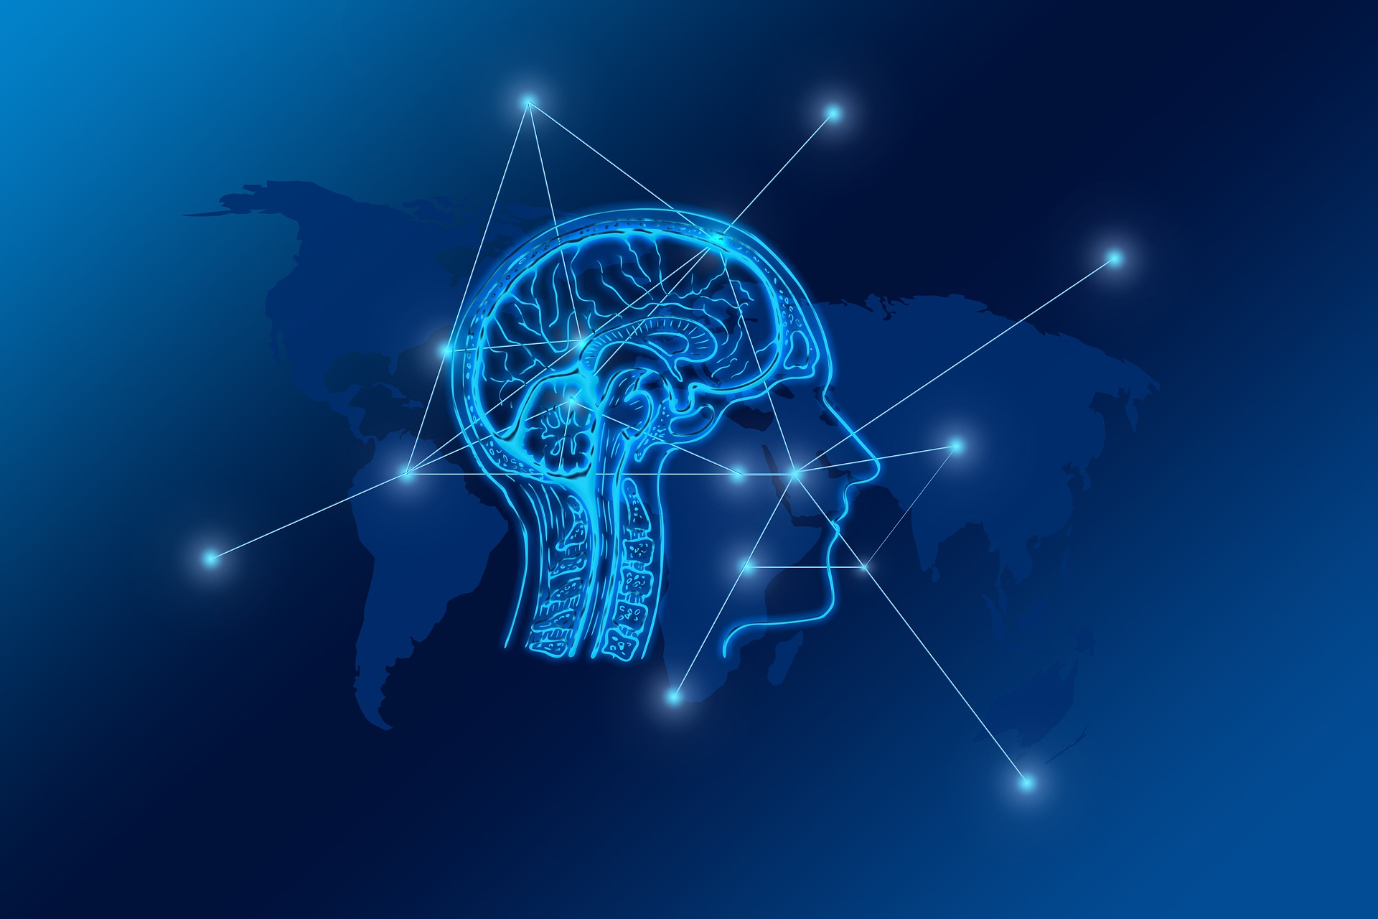
Transfer learning
Other algorithms , modules, APIs
Tensorflow
Keras
Models Pretrained Models from Tensorflow Model Zoo & Activate Object Detection
Install CocoAPI
Install the Object Detection API

Slide 9
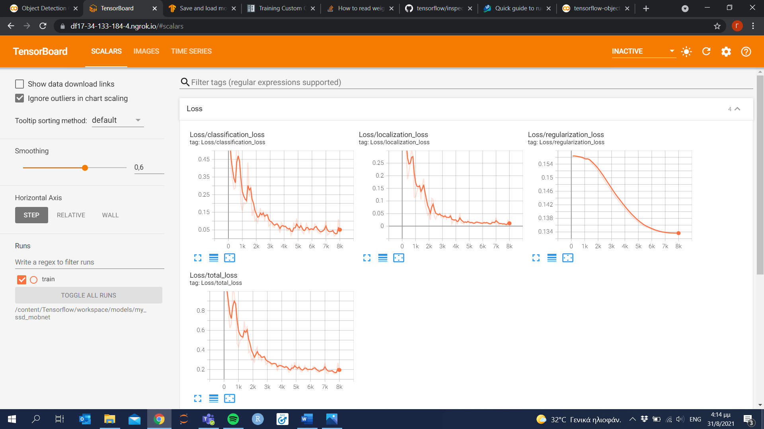
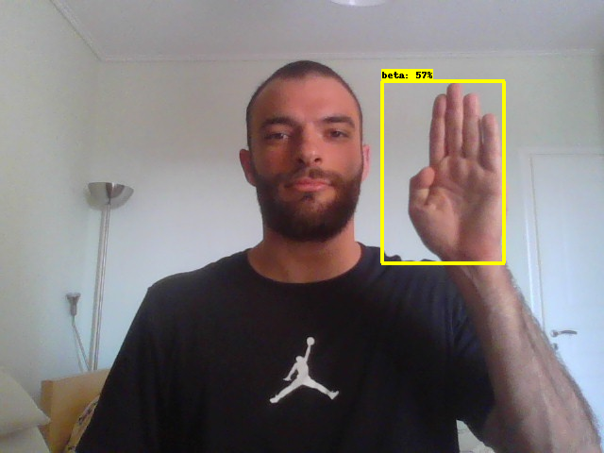
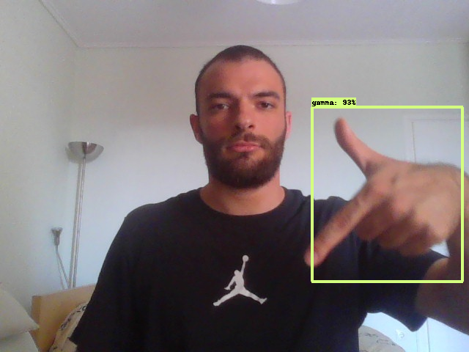
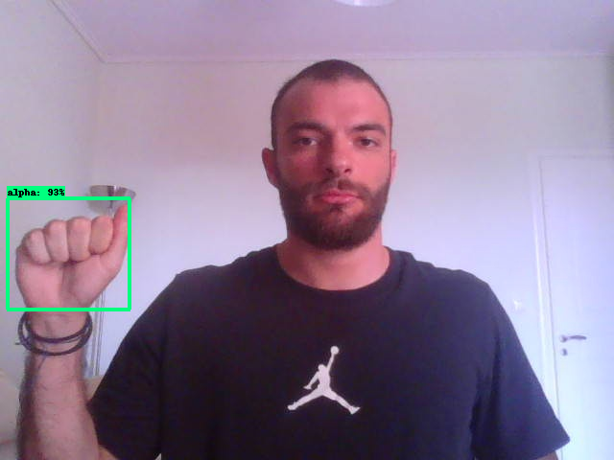
Results & Quantitative analysis

Slide 10

Future plans
Detect Signs in Real-time manner.
Video dataset.
Build Vocabulary from words, not only letters.
Bigger computational power, better training.
Voice spelling of letters and words for the co-speaker.
Deploy into production.

Slide 11


Thank you!

